Slide 1
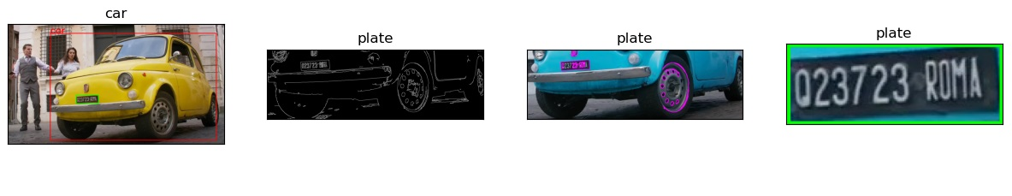
Plate Detection
AAAIV 2023/24 - Agata Cavigioli, Giovanni Sgambato

Slide 2
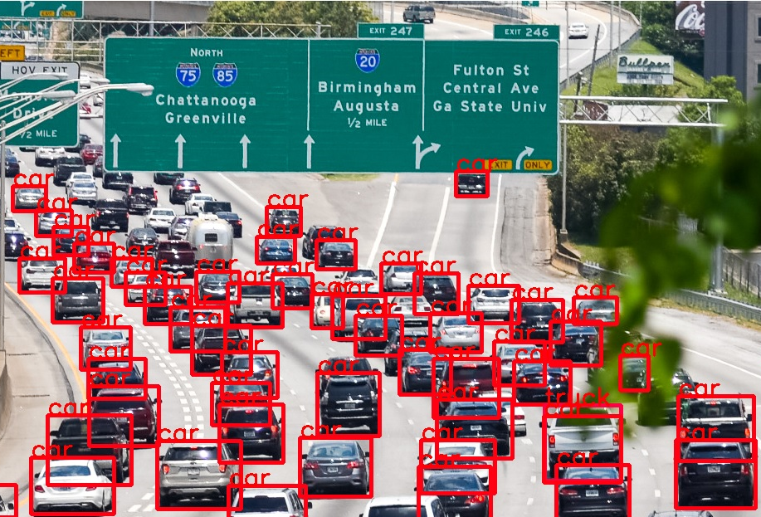
Motivation of the Work
The detection of vehicles and the efficient extraction of license plates from images are crucial elements in surveillance systems, road safety, and traffic management.
This proposal addresses the need to develop a system capable of identifying cars and extracting their license plates accurately.
The aim is to provide a robust solution allowing automated recognition and registration of vehicles in complex environments.

Slide 3
Proposal Objective
The primary objective of this project is to implement a vehicle detection system, and subsequently extract the license plates using image processing techniques and optical character recognition.
The purpose is to offer a comprehensive solution that enables precise and efficient identification and registration of vehicles in various conditions and environments, and propose an efficient and robust method.

Slide 4
Technical Description of the Work Done
The implementation of YOLO is based on a pre-trained model capable of detecting various objects, including vehicles, in images.
This technique allows for the accurate identification of cars within a diverse set of objects.
The first part of the project consists of detecting a car in an image and separating it from the background with the typical rectangle segmentation tool.
In the second part we trained a custom Yolo model with a specific plate’s dataset

Slide 5
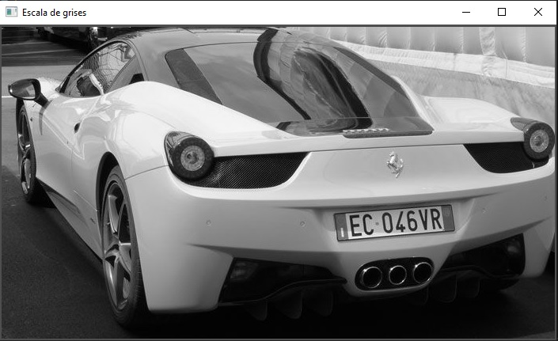
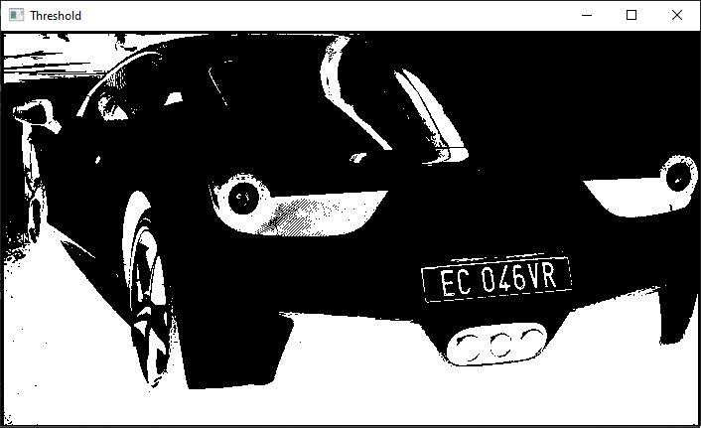
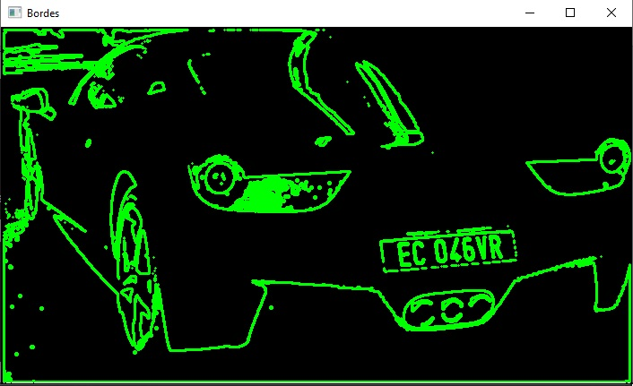
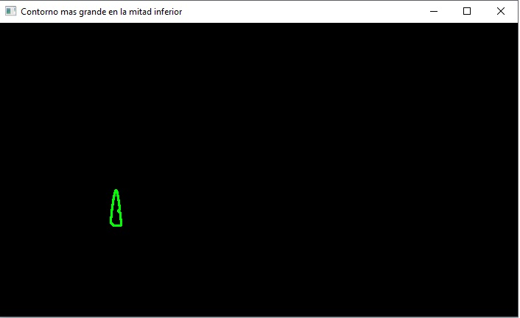
First Attempt of Extraction of Vehicle License Plates
The methodology used for license plate extraction relies on image processing techniques and contour detection.
This stage aims to isolate and segment the license plates of detected vehicles for further analysis.
However, this initial approach faced challenges in accurately extracting license plates due to variations in lighting, angles, and image quality.

Slide 6
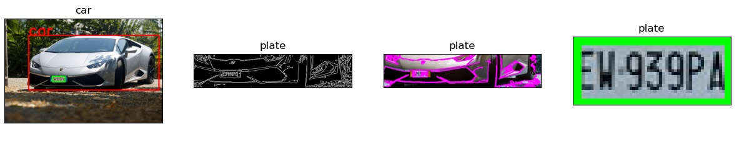
Second Attempt of Extraction of Vehicle License Plates
In the second attempt, the focus shifted towards a refined approach for license plate extraction after vehicle detection with a more comprehensive methodology specifically tailored to extract license plates from the regions identified as vehicles in the images.
The integration of Tesseract OCR enables the recognition and extraction of text present in the identified license asc
as

Slide 7
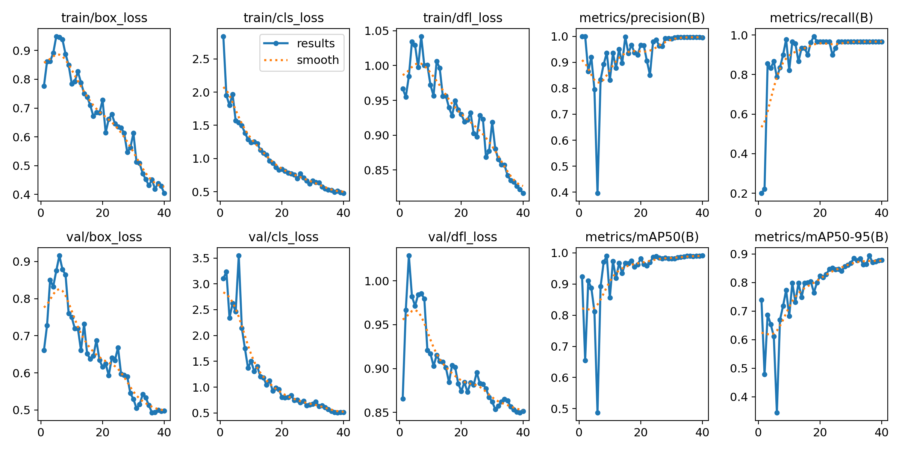
Custom Trained YOLO Model
In this phase, our approach diverged from manual processing. We trained a custom detector using YOLOv8, utilizing a dataset from Roboflow.
Upon successful training, a visual summary showcased the reduction in loss function and the precision enhancement per epoch, confirming a fruitful training session. With the training accomplished, we introduced the model plate—our trained detector primed to spot license plates. We then formulated a detection function to adeptly identify and display license plates within vehicle images.

Slide 8
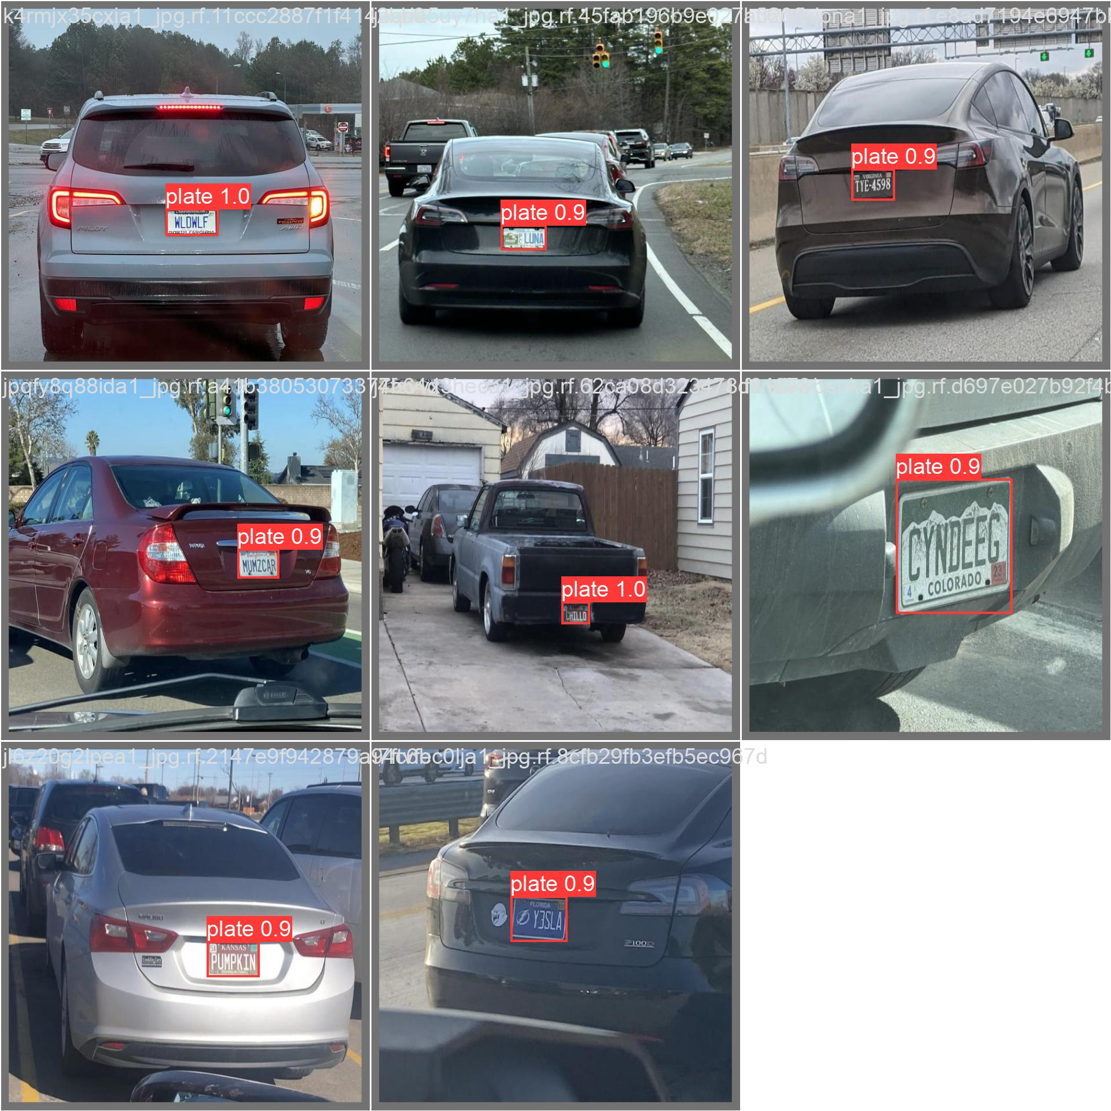
Custom Trained YOLO Model

Slide 9
Sources and Technologies Used
Various technologies and tools were employed in this project, including:
OpenCV for image processing,
YOLO v8 for object detection
Tesseract OCR for optical character recognition.
These technologies offer robust and complementary capabilities that were crucial in developing a comprehensive system for detection and license plate extraction.

Slide 10
References
Ideas
https://www.cnet.com/a/img/resize/mission-impossible-dead-reckoning-fiat-500.jpg
Yolo
https://inside-machinelearning.com/en/yolov8-how-to-use/
https://inside-machinelearning.com/en/bounding-boxes-python-function/
Custom model (Roboflow)
https://blog.roboflow.com/how-to-train-yolov8-on-a-

Slide 11
Conclusions and Future Developments
The results obtained in vehicle detection and license plate extraction showed considerable efficacy in accurately identifying cars and recognizing plates under diverse conditions. However, areas for improvement were identified to increase the system’s accuracy and performance in more challenging environments.
To enhance the system’s efficiency and precision: exploring advanced image processing techniques and specific model training for plate recognition under different lighting conditions and format variabilities is proposed. Additionally, integrating post-processing algorithms could increase the performances.
Another interesting path of investigation would be working on video instead of images.

